Slide 1

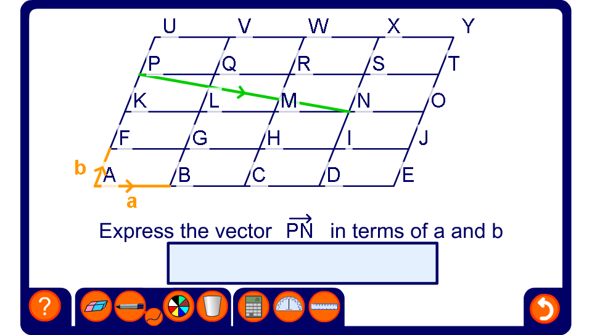


A grid of congruent parallelograms
Notes:
In this activity the vectors a and b form the basis of the grid. Explain that this means that any point on the grid can be expressed in terms of these two vectors.
This is true for any two non-parallel vectors.

